Slide 1
Finding Parallel Edges using Incidence Matrix of a Directed Graph
Assignment 1 - Topics in Graph Theory

Slide 2
Introduction
Given a graph G = (V, E), the problem is to find the representation for incidence matrix of a directed graph and identify all parallel edges when the graph is seen as a directed graph and when it is seen as undirected graph.
The parallel edges are those edges which share the same pair of end point vertices.
In case of directed graph, these are of two types :
Parallel
Anti-Parallel
The Incidence matrix for a directed graph is an N*M matrix where N = no. of vertices and M = no. of edges in the graph.

Slide 3
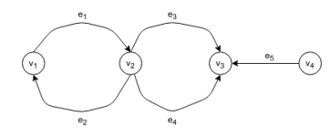
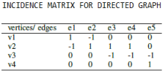
Incidence Matrix and Parallel Edges
For a directed graph, the incidence matrix I_{N*M} is a matrix such that :
I[i][j] = 1 if edge ej is coming out of vi
I[i][j] = -1 if edge ej is going into the node v_{i}
I[i][j] = 0 Otherwise
Example : In below given graph, (e₁,e₂) and (e₃,e₄) form pair of parallel edges.

Slide 4
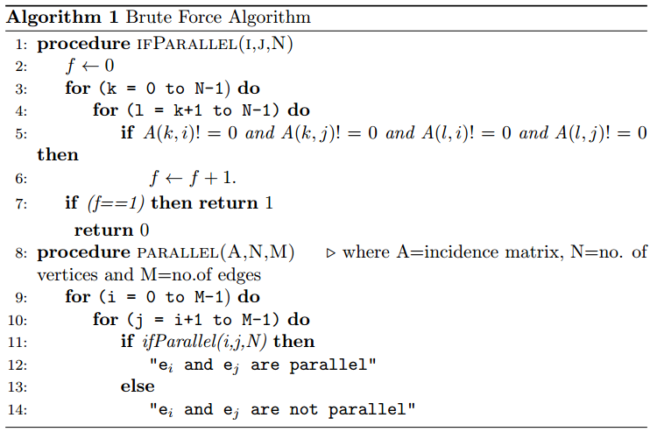
Approach 1 : (Time Complexity = N²*M²)

Slide 5
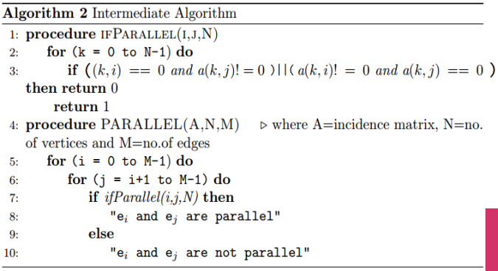
Approach 2 : (Time Complexity = N*M²)

Slide 6
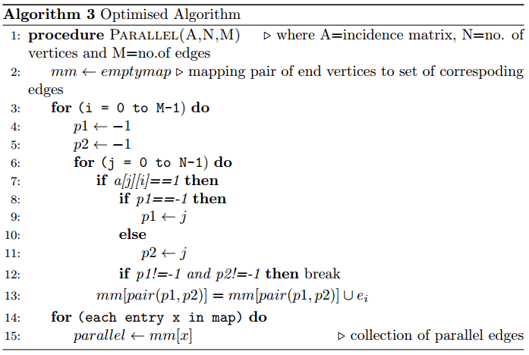
Approach 3 : (Time Complexity = N*M) MMM*Log( M*Log(M))

Slide 7
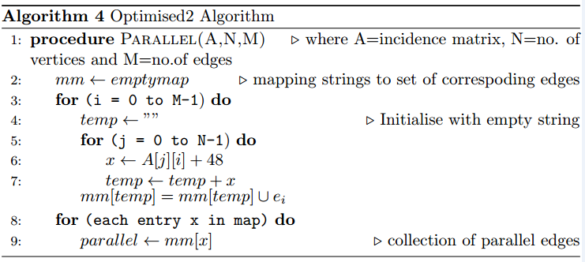
Approach 4 : (Time Complexity = N*M)

Slide 8
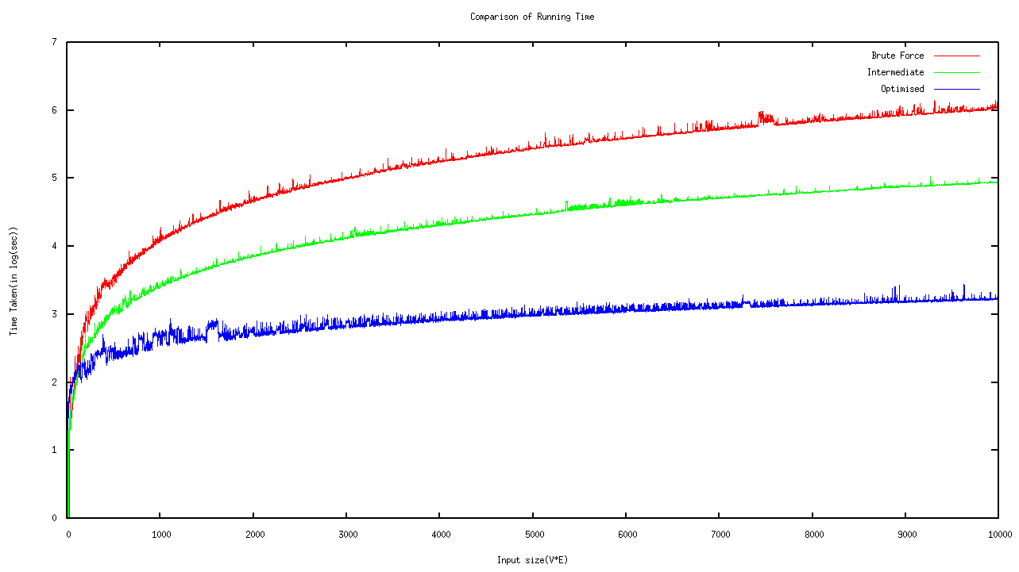

Slide 9
Conclusion
Any directed or undirected graph can be represented using incidence matrix.
This incidence Matrix can be traversed to find the parallel edges.
Three algorithms have been introduced for the same :
Brute Force Algorithm - O(N²*M²)
Intermediate Algorithm - O(N*M²)
Optimised Algorithm - O(N*M)

